Slide 1
Machine Learning Techniques for Stress Prediction among working IT professionals due to WFH(work from home)
Under the supervision of:
Dr. Subrajeet Mohapatra
Assistant Professor
Presented By:
Nikesh Kumar
MT/ITY/10011/20

Slide 2
Introduction
Stress disorders are a common issue among working IT professionals in the industry today.
According to a study by the industry association, Assocham, more than forty-two percentage of working professionals in the Indian private sector suffer from depression or general anxiety disorder due to long work hours and tight deadlines.
Due to covid-19, WFH(Work From Home) working culture was introduced, managing the family and office from the same place was a challenge.
Implementation of different machine learning models to predict is stress due to WFH.

Slide 3
Motivation
Human–computer interaction is research in the design and the use of computer technology, which focuses on the interfaces between people and computers.
Machine learning is the field I was always interested in.

Slide 4

Objective
Stress Prediction among working IT professionals due to WFH(work from home) using Machine Learning techniques.

Slide 5
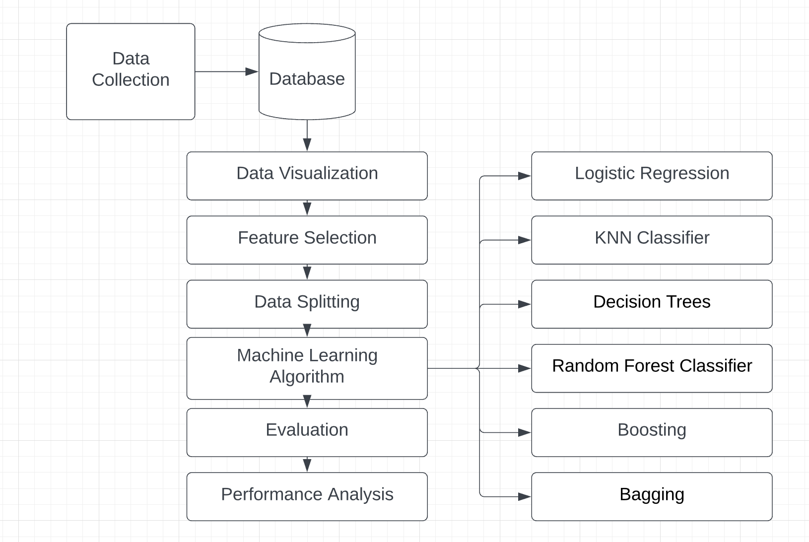
Methodology
Flow Chart

Slide 6
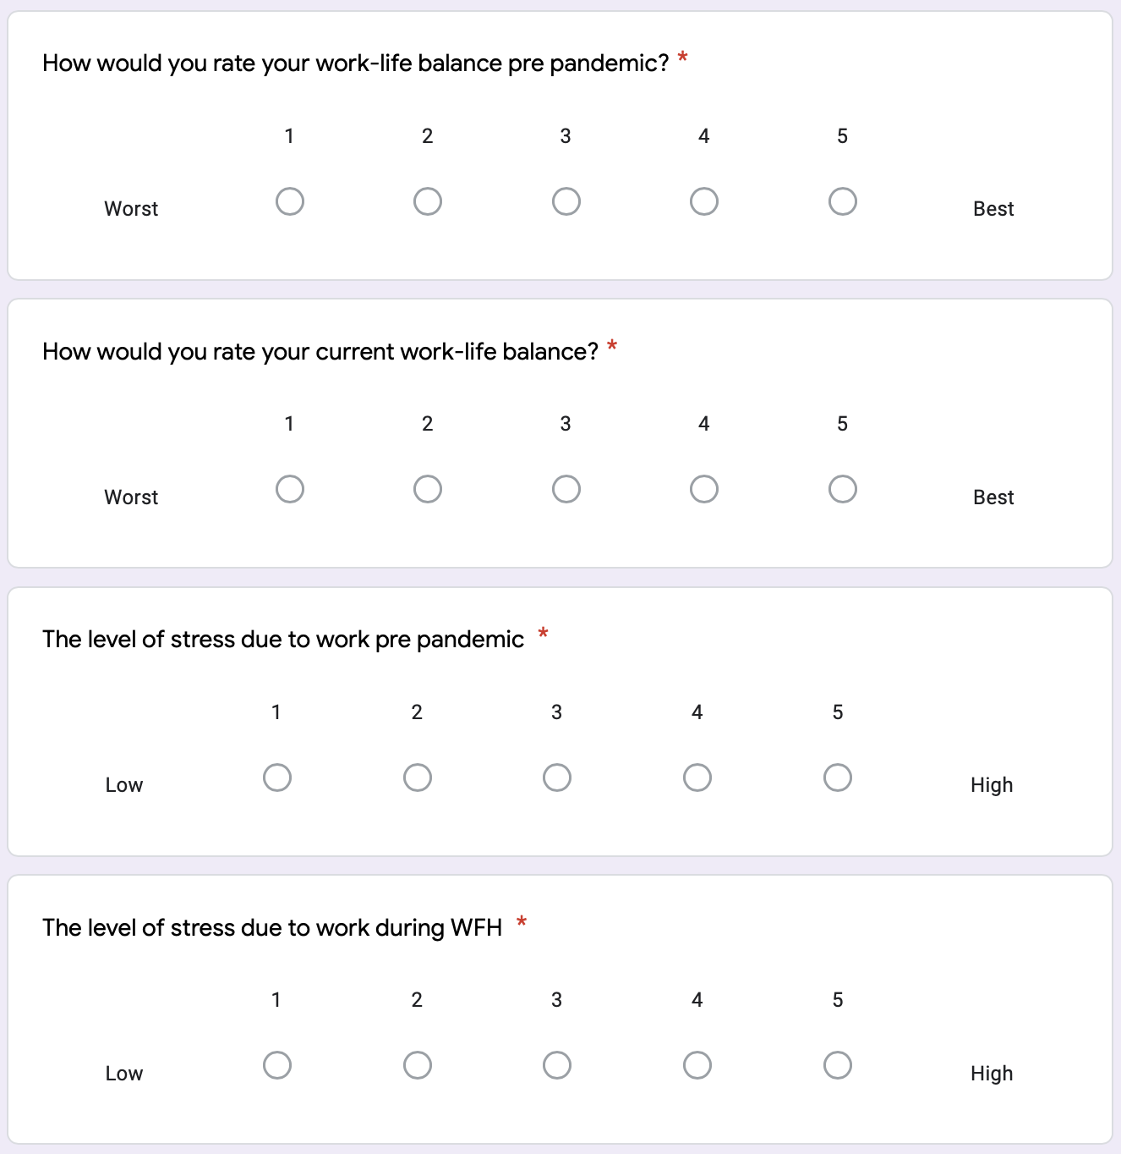
Data Collection
Google form of 43 questions based on personal details , family, work-life balance and stress, was made to be circulated among the IT professionals.
Google form link: https://docs.google.com/forms/d/e/1FAIpQLScc0DZ5MaMKkeYzOYtRlJ_xd3RrwFVekxn3rD44twsVWFdelQ/viewform?usp=sf_link
Work-life related sample questions

Slide 7
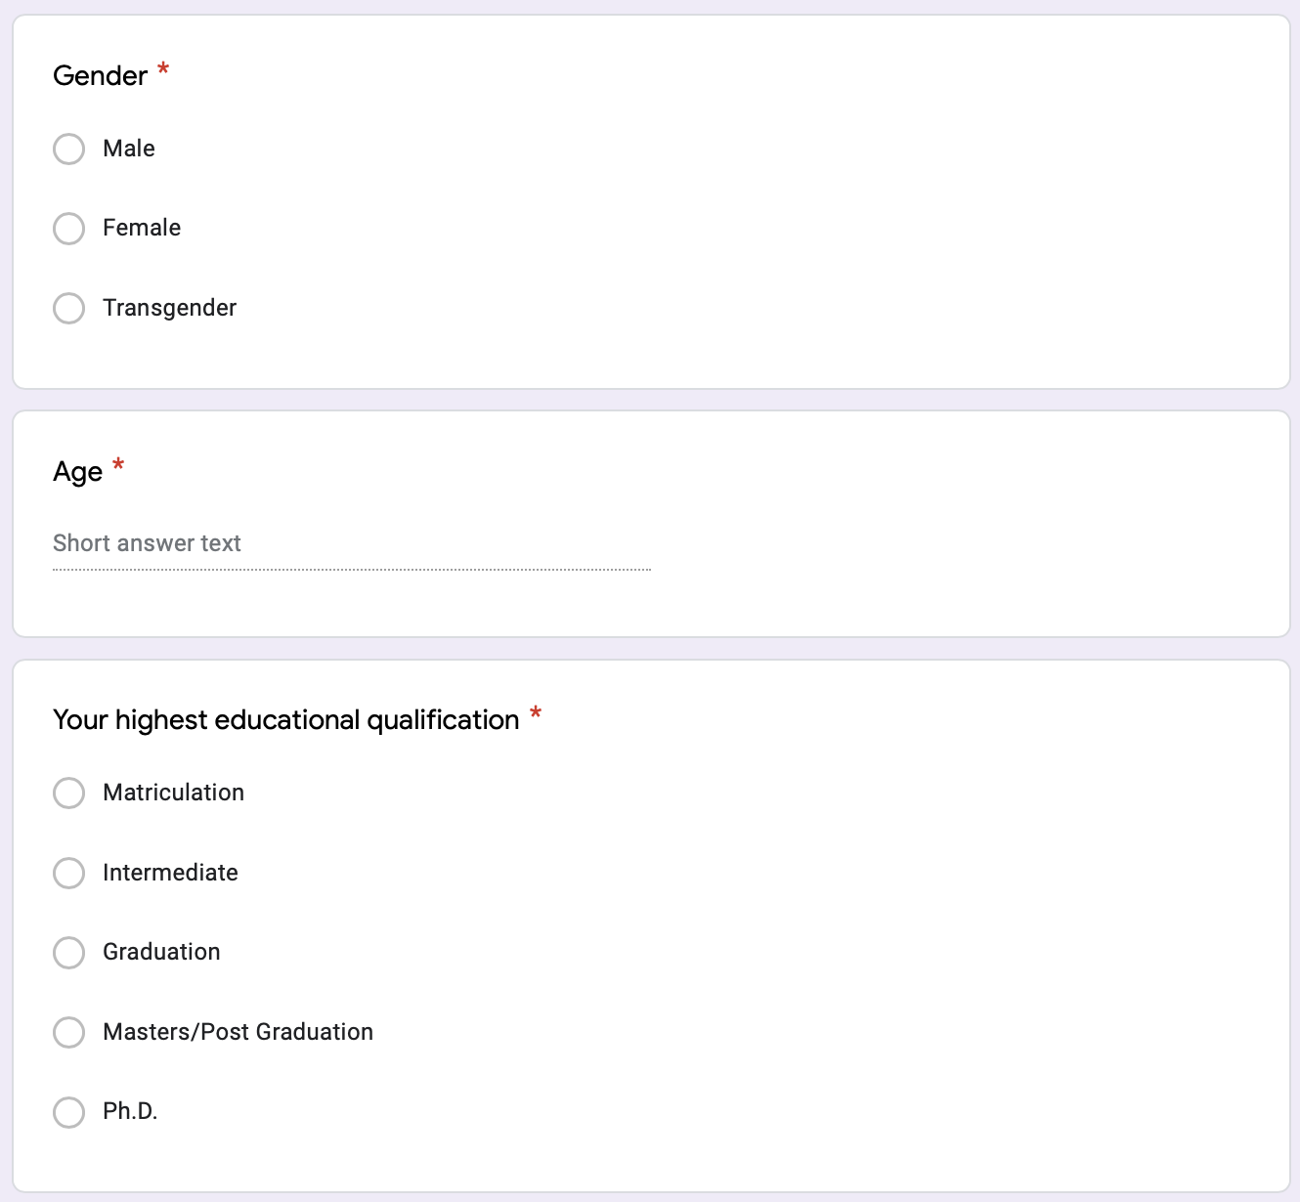
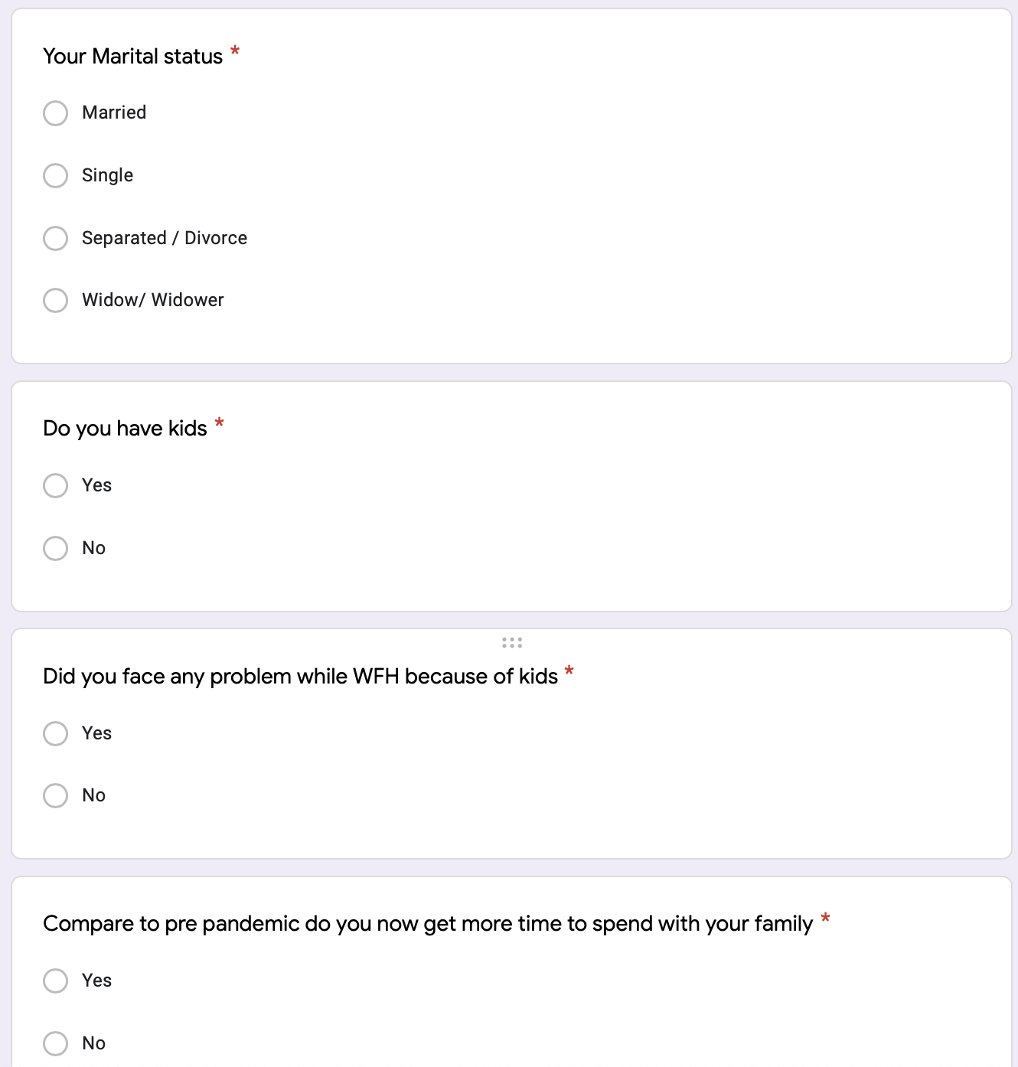
Questions related to personal demography
Questions related to family

Slide 8
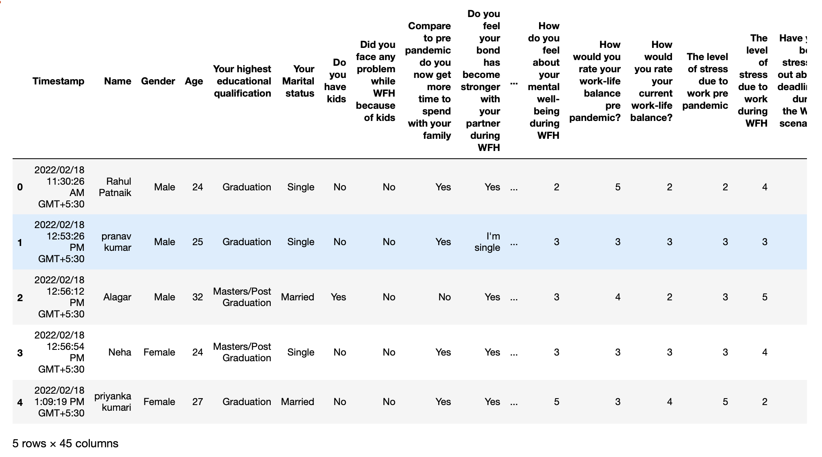
Data Description
Sample size is 243
Total 43 attributes spanning over personal demography, family related, work and stress related.

Slide 9
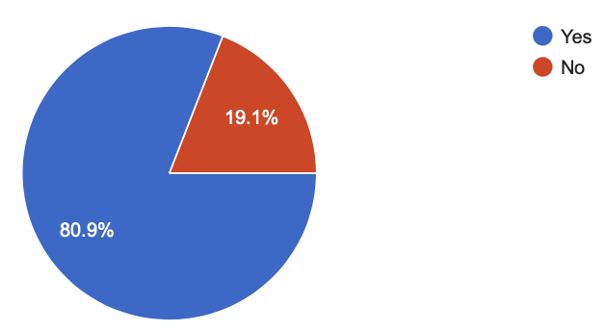
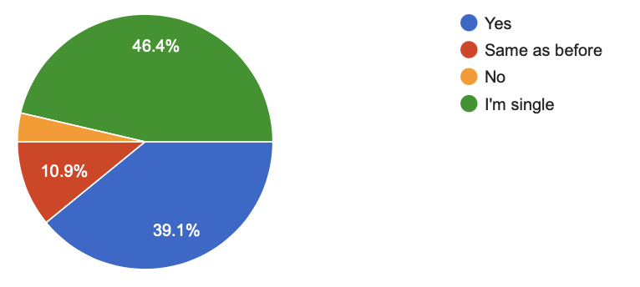
Data Visualization
3.6%
Compare to pre pandemic do you now get more time to spend with your family?
Do you feel your bond has become stronger with your partner during WFH?

Slide 10
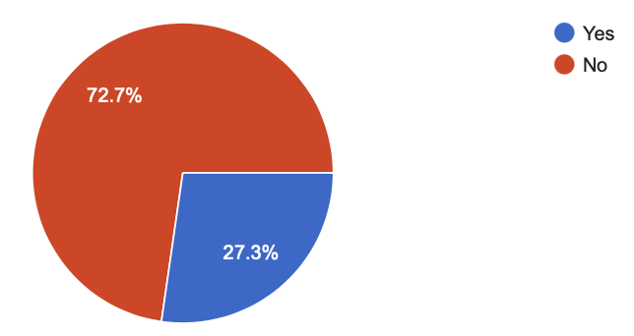
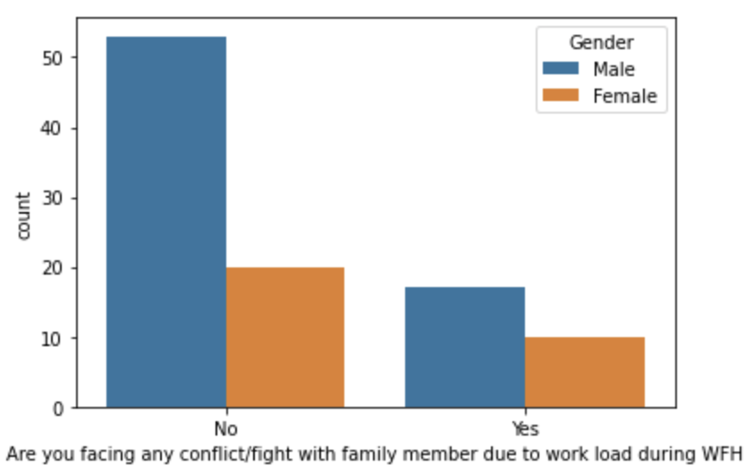
Are you facing any conflict/fight with family member due to workload during WFH

Slide 11
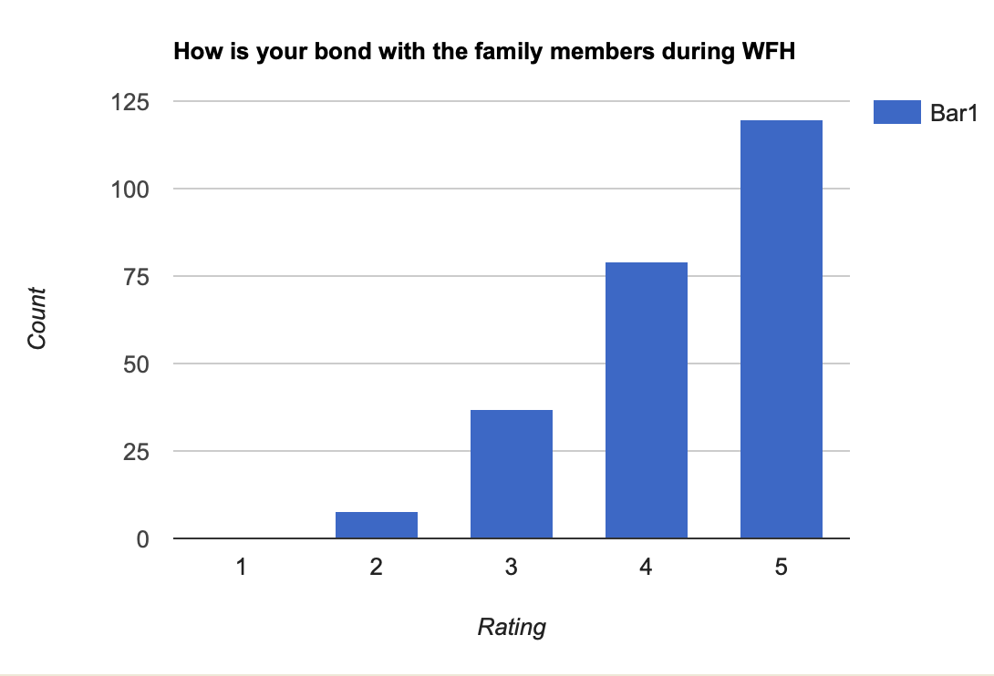
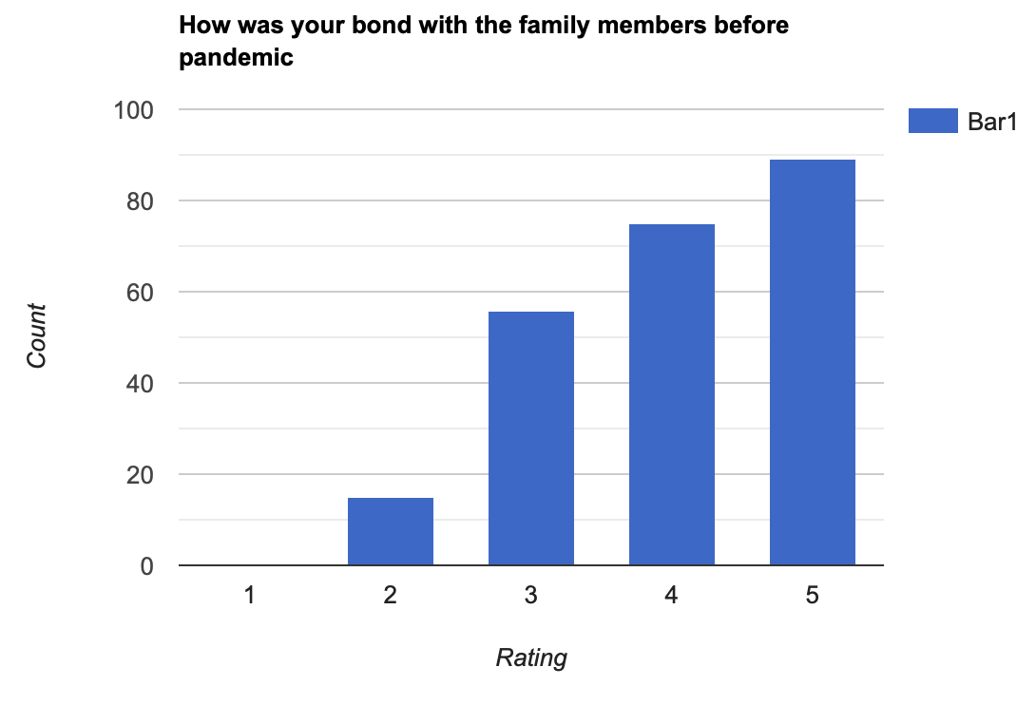

Slide 12
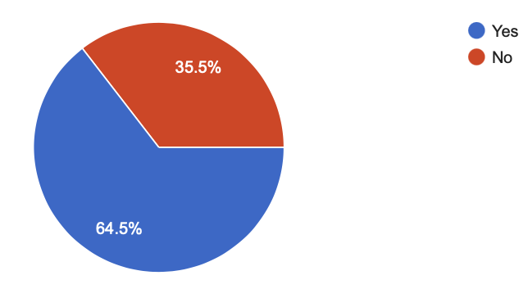
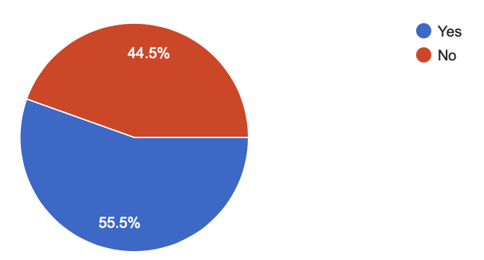
Currently are you working from home(WFH) ?
Willing to WFH permanently

Slide 13
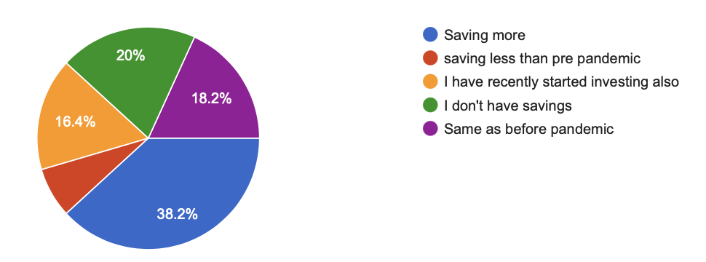
7.3%
Financial stability status During Work From Home

Slide 14
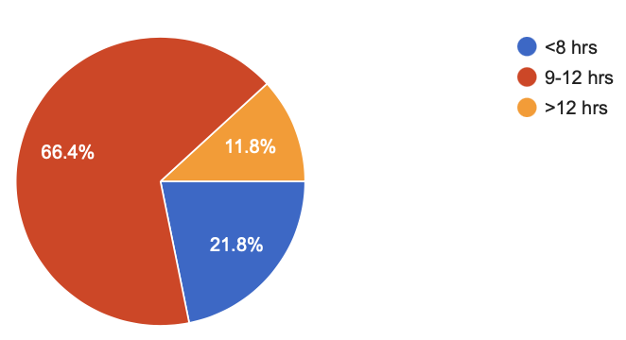
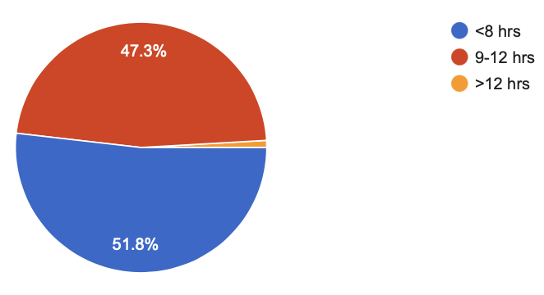
Working hour before pandemic
Working hour during WFH

Slide 15
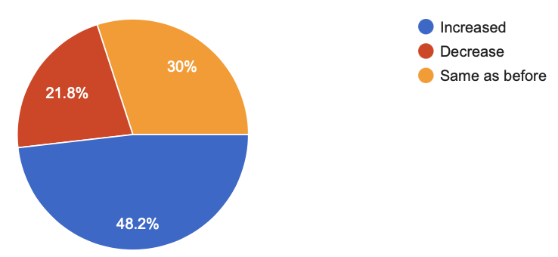
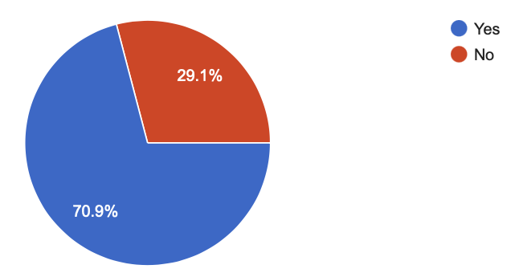
Your work efficiency during WFH?
Have you experienced an increase in your working hours?

Slide 16
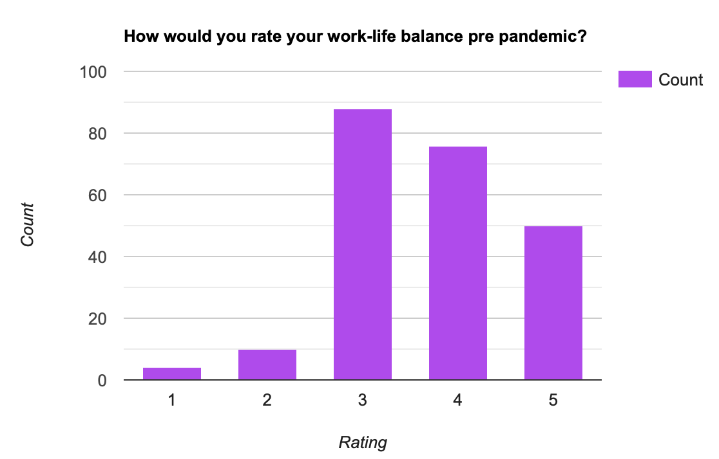
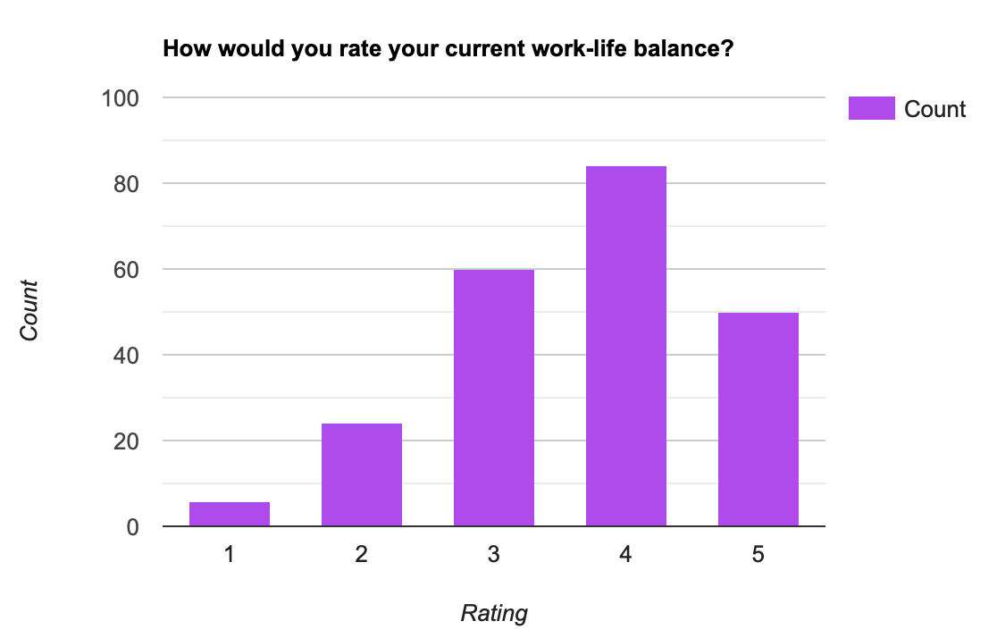

Slide 17
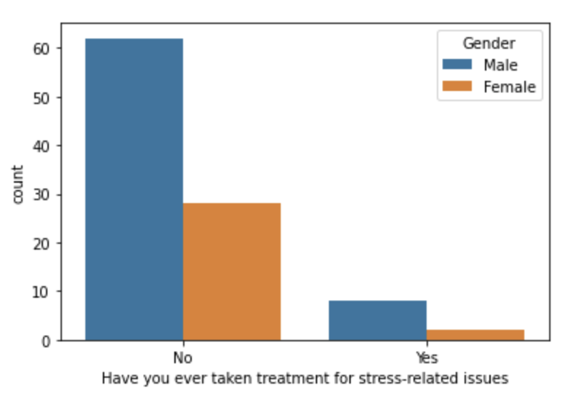
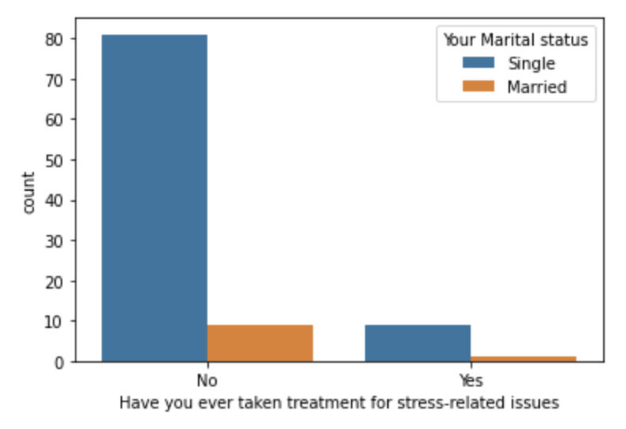

Slide 18
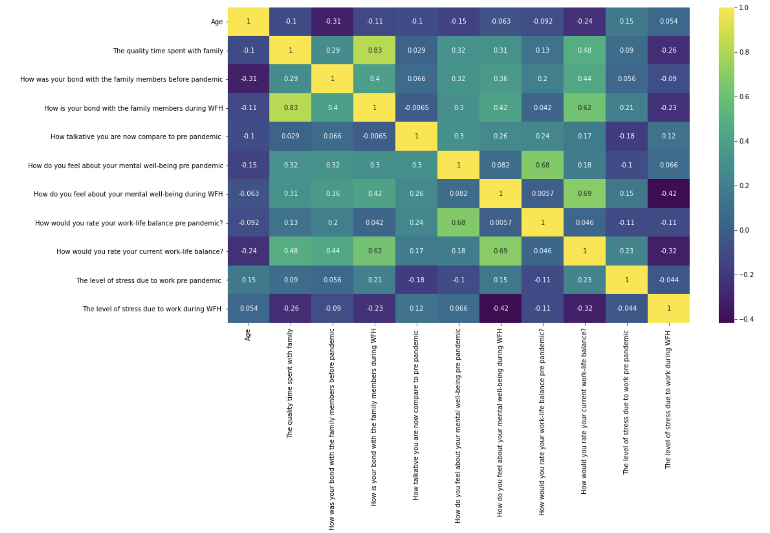

Slide 19
Data Preprocessing
Data Cleaning: In order to have a specific model some of these attributes have been neglected and finally 15 out of these above parameters were taken into consideration based on their relevance to our research.
Duplicates and NA values were deleted.

Slide 20
Feature selection
14 relevant attributes to be independent variables
The possibility of an employee having stress and needing treatment as the dependent variable which is to be predicted by the trained model.

Slide 21
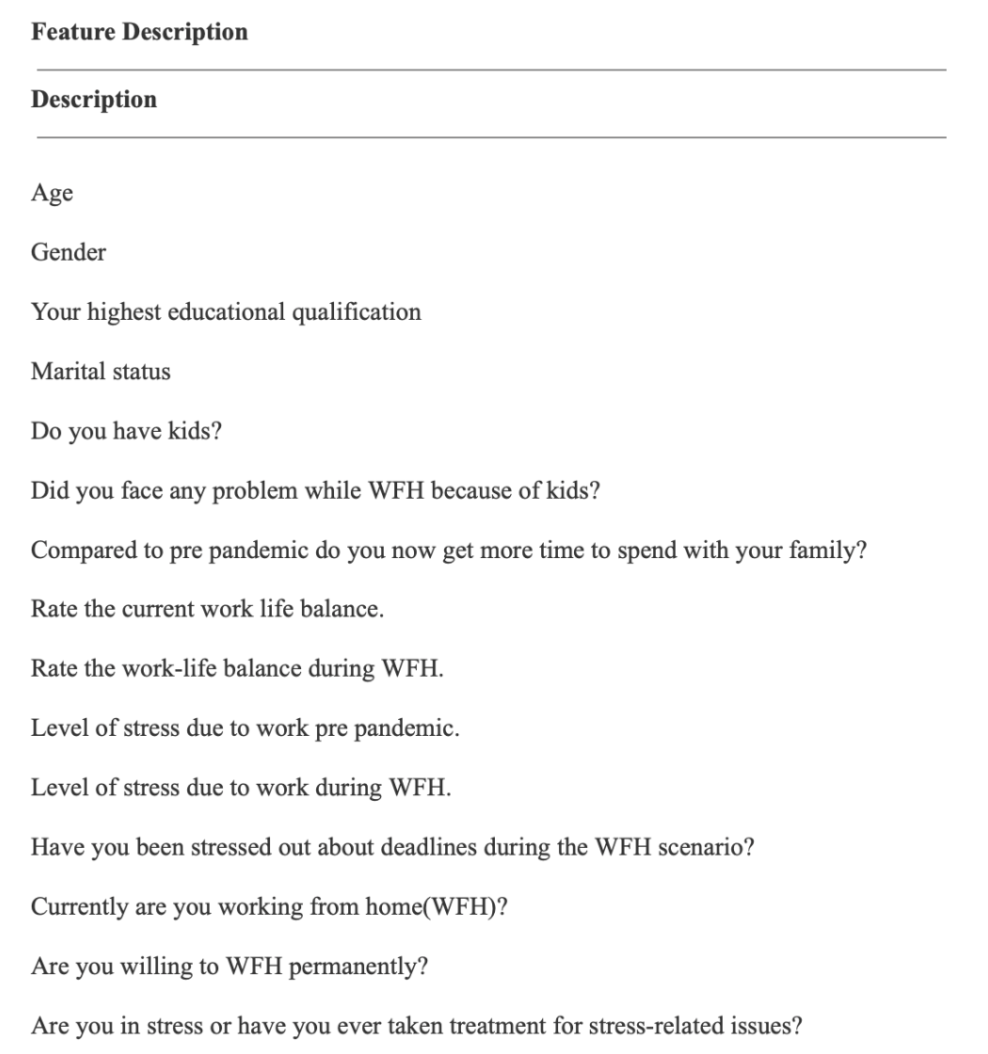

Slide 22
Splitting Data
After feature selection the data is splitted into two sets namely the training set and testing set.
70% of the data is used for training or fitting the model while the rest
30% of the data is spared for testing and evaluating the performance.

Slide 23
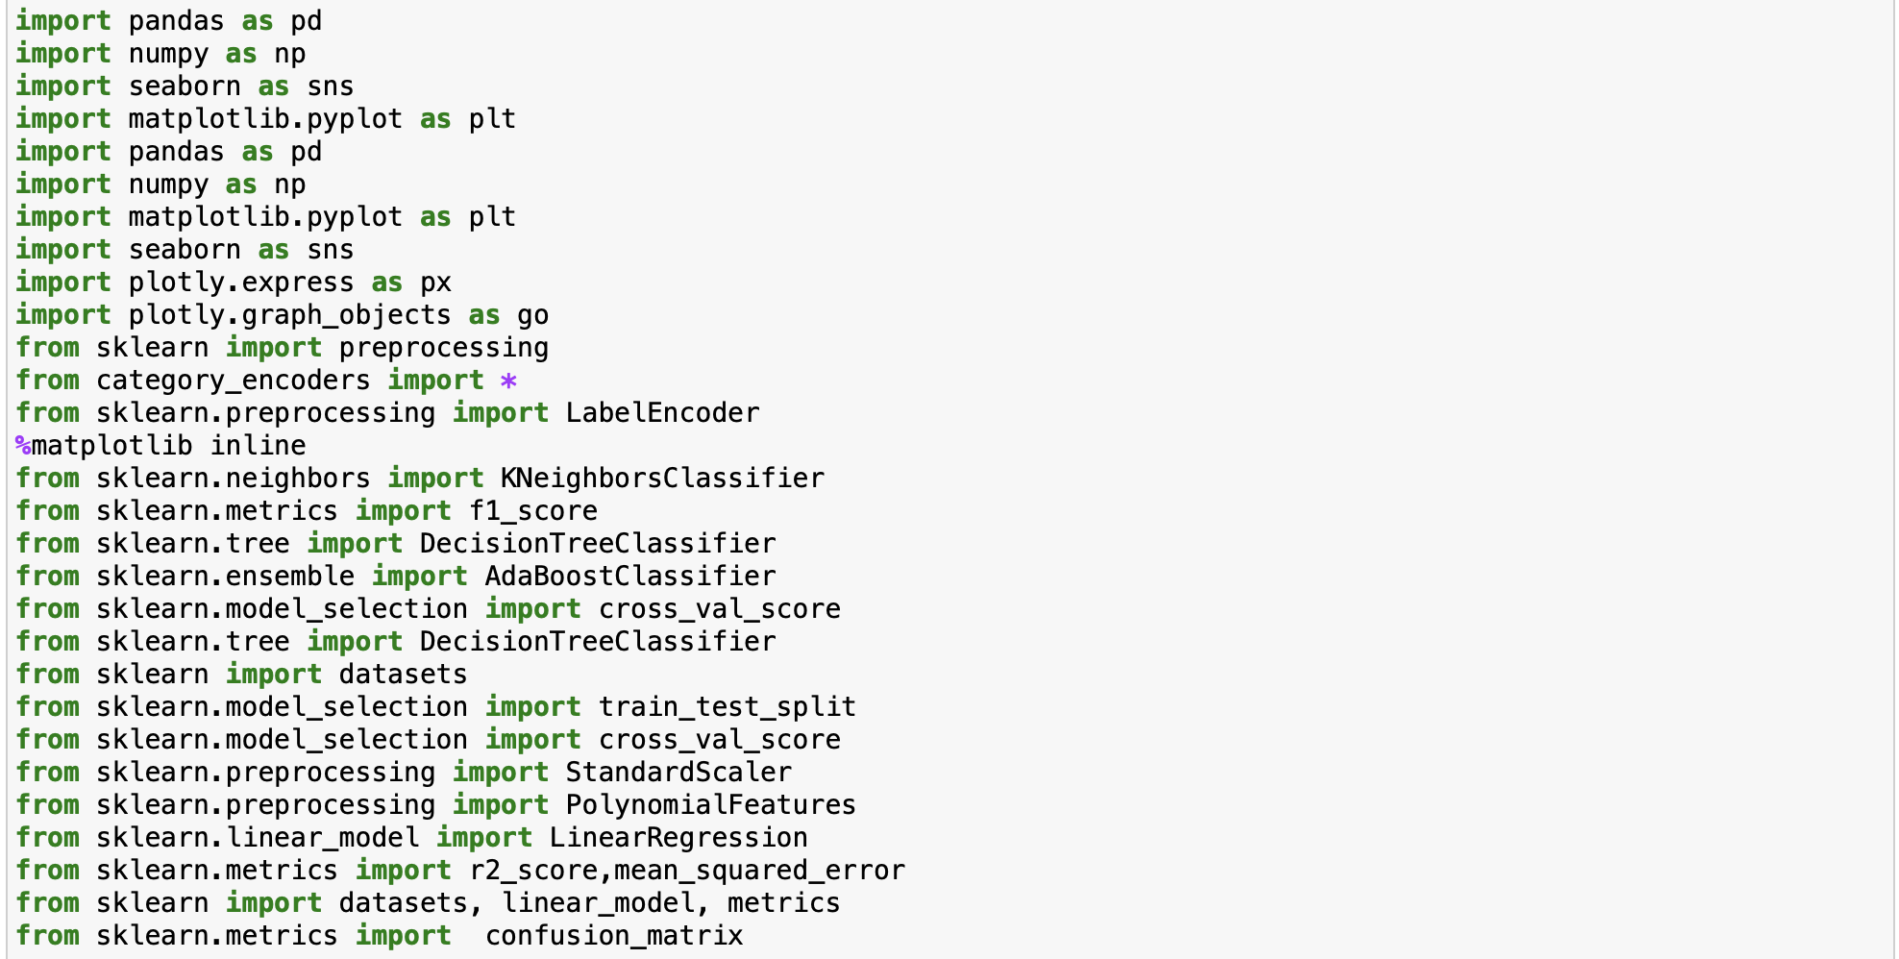
Libraries used:

Slide 24
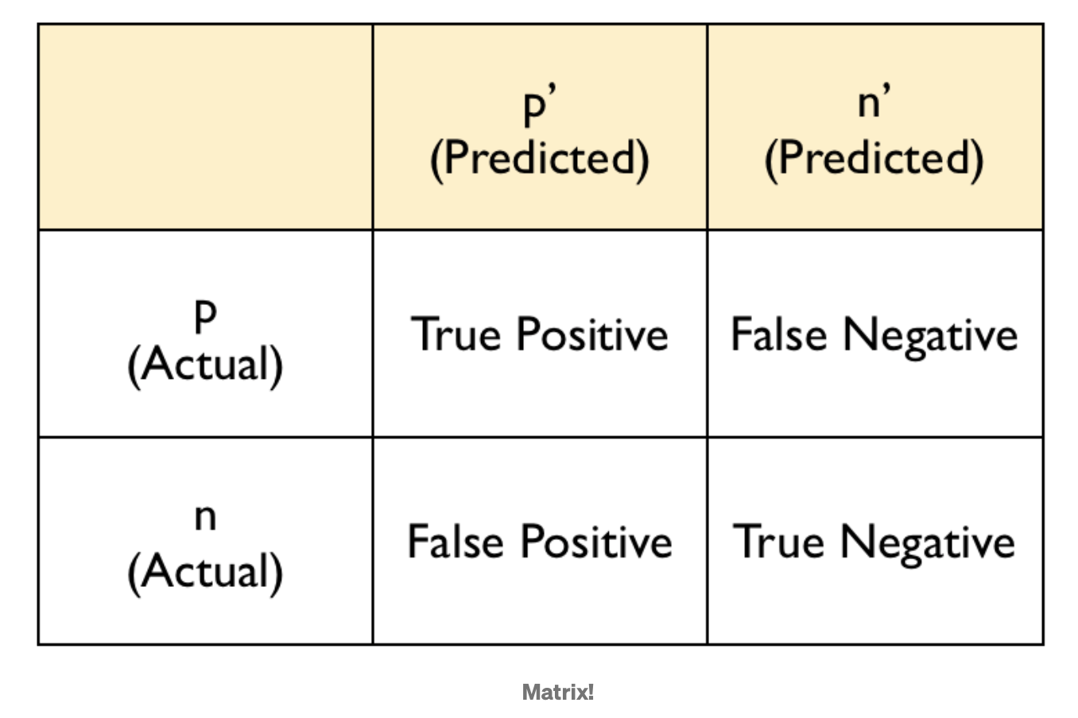
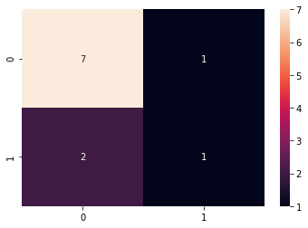
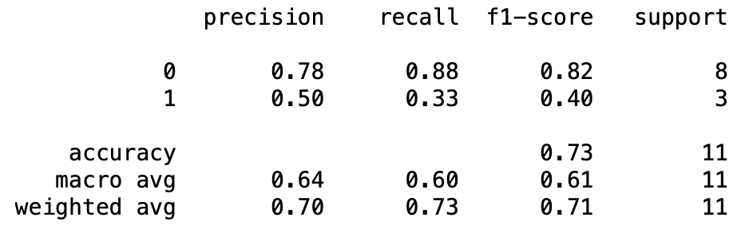
Algorithms
Logistic Regression:
This predictive analysis used in scenarios where one binary variable is dependent on one or more independent variables.
Confusion matrix was created to predict accuracy

Slide 25
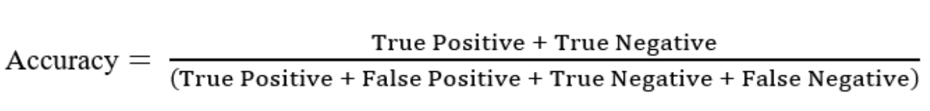
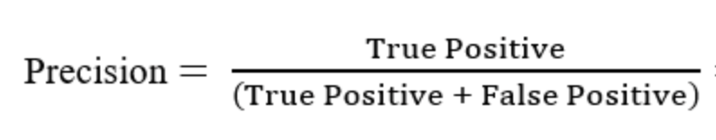
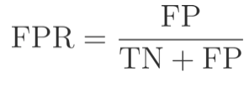
Classification Accuracy:
Is a measure which is concerned with all the effectiveness related to classification models.
Precision:
It is implied as the measure of the correctly identified positive cases from all the predicted positive cases.
If an employee is dealing with stress and requires treatment, the model identifies the comparable one. Furthermore, greater precision indicates that the model is performing well in identifying all persons who require treatment.
False Positive Rate:
It is basically a measure based on how much amount of instances the model classified a negative event as positive.
In our current scenario, it would mean that the model classifies a person as needing help, to cope up with stress and mental health related issues although the person in question here feels perfectly alright. Hence we can see that lower the false positive rate, better the model.

Slide 26
AUC Score:
Area Under the Curve which is abbreviated as AUC.
It is useful in particular analysis criteria, to measure the performance of different models to determine which model predicts the classes best.
Receiver Operating Characteristics (ROCs) is considered a part of AUC and it is here the plot of the true positive rate with the false positive rate.
Area under a ROC curve signifies how well the model can predict a positive classification correctly.
Cross-validated AUC:
A factor which is a major aspect for the formation having a prediction model to ensure mainly about the stability.
To do so, the Cross-validation approach is used, in which a model uses a portion of the training samples as test data and then fits our model to the outcome.

Slide 27
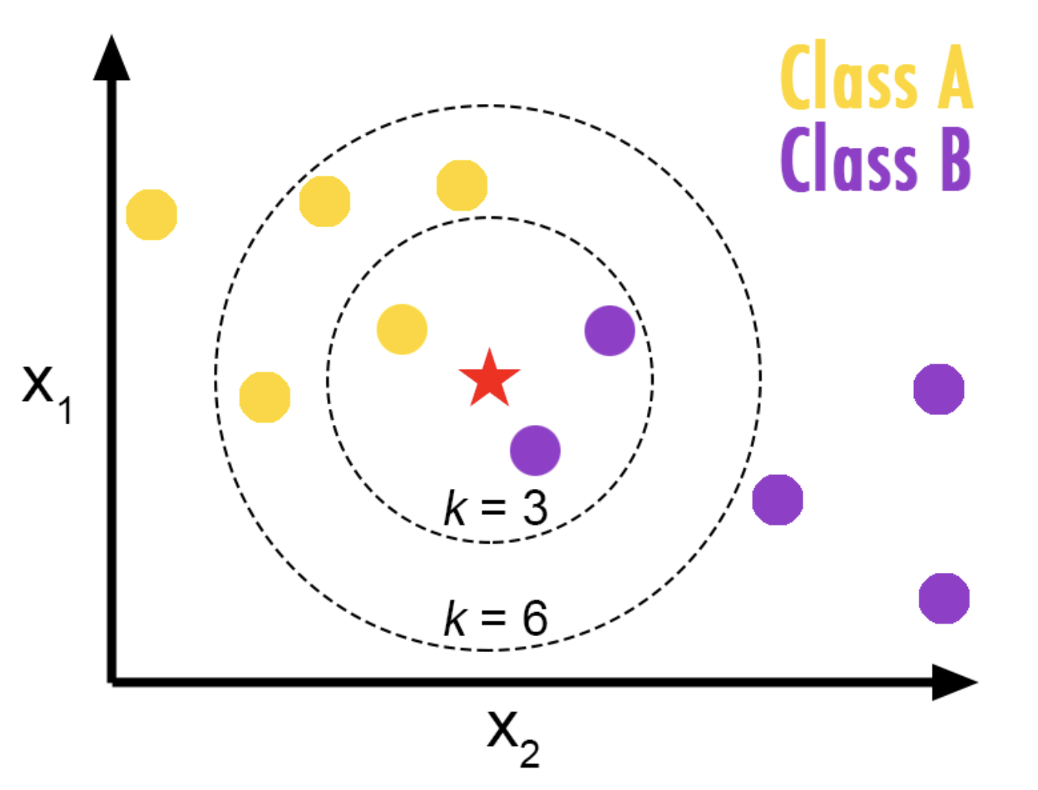
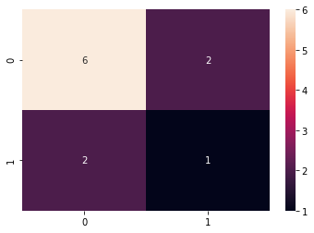
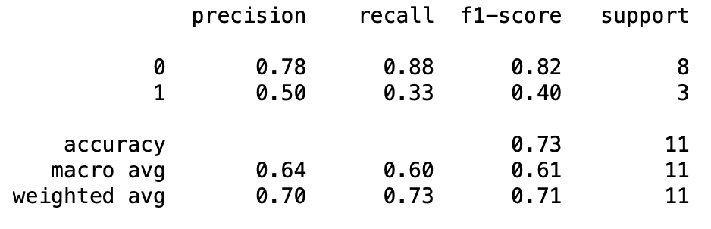
K-NN(K-Nearest Neighbour):
K-Nearest Neighbor (KNN) classifier is a supervised learning algorithm that can be implemented on labelled data.
Here value of K = 11.

Slide 28
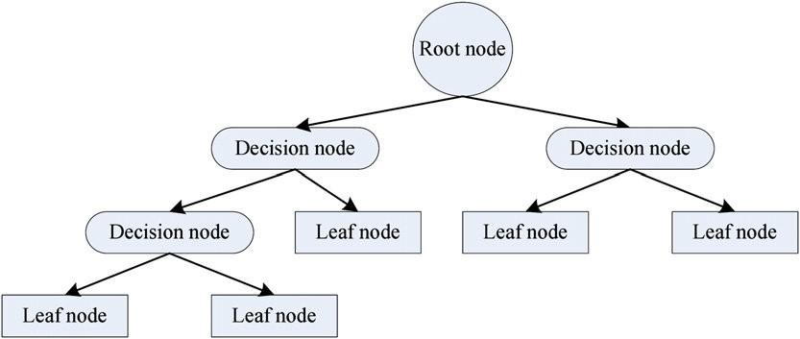
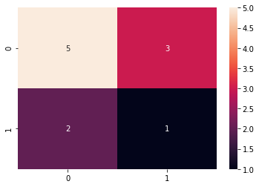
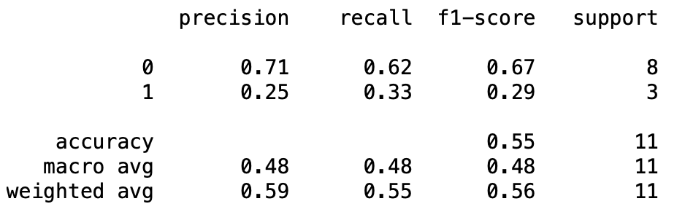
Decision Tree:
A decision tree is a tree where each node represents an attribute, each branch represents a rule, each leaf represents a categorical or continuous value.

Slide 29
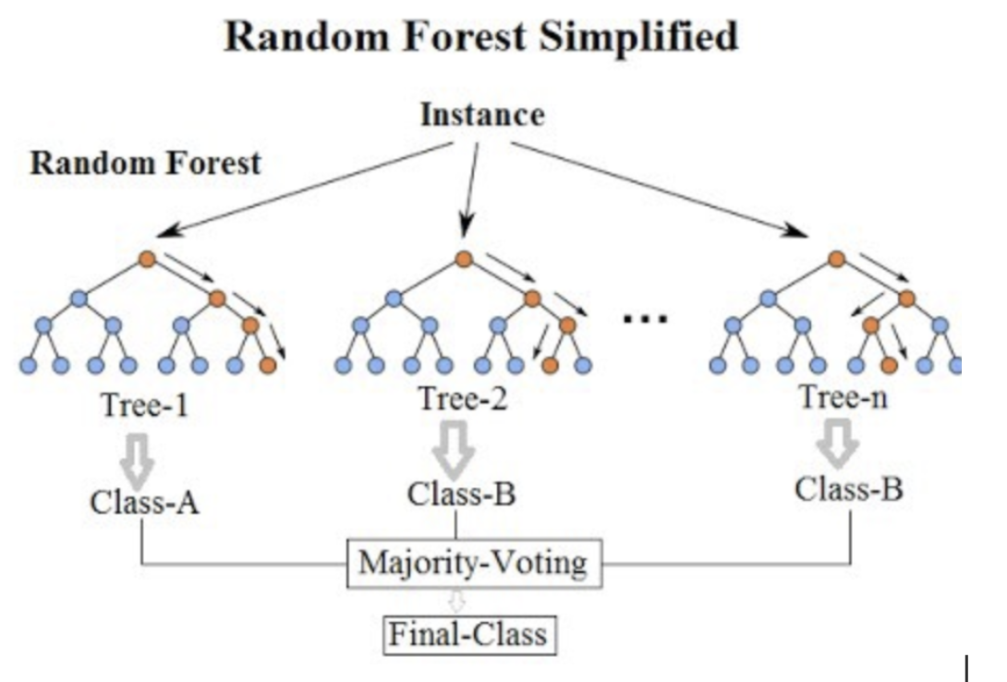
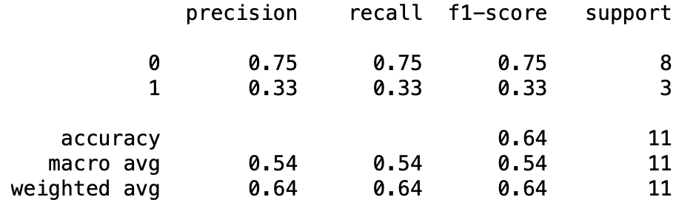
Random Forest:
Random forests or random decision forests are an ensemble learning method for regression, and other tasks that operates by constructing a multitude of decision trees at training time.
For classification, the output of the random forest is the class selected by most trees.

Slide 30
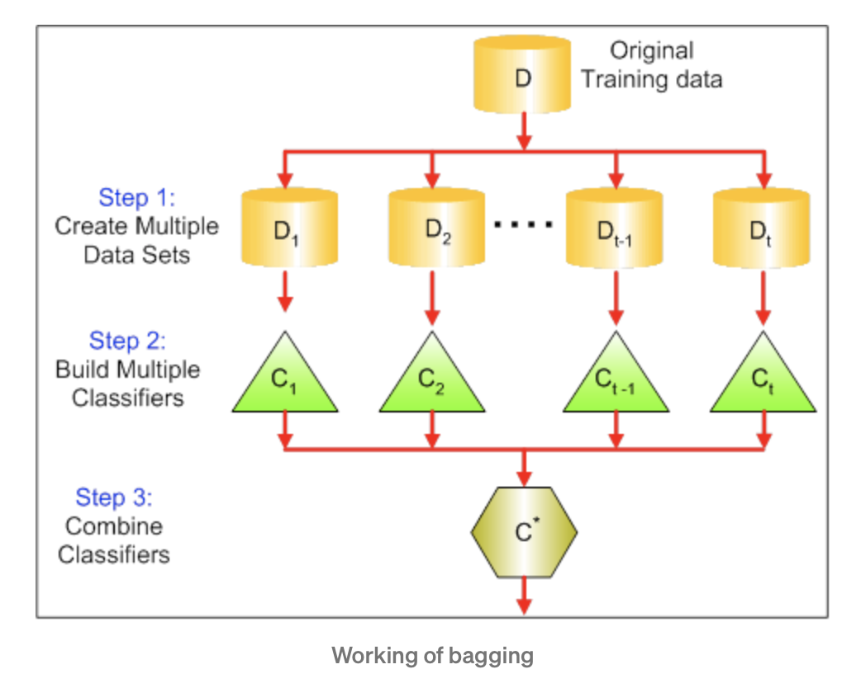
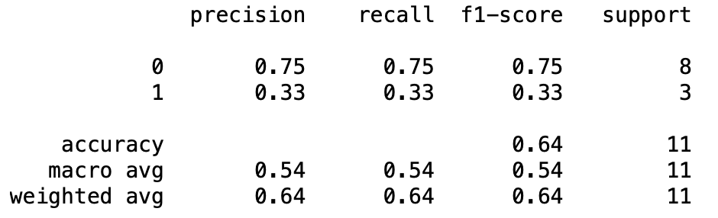
Bagging:
Bagging is one of the most important techniques which is also called bootstrap aggregating which sits over the majority of the most voting principle.
Bagging is an ensemble technique mainly used to reduce the variance of our predictions by combining the result of multiple classifiers modelled on different sub-samples of the same data set.

Slide 31
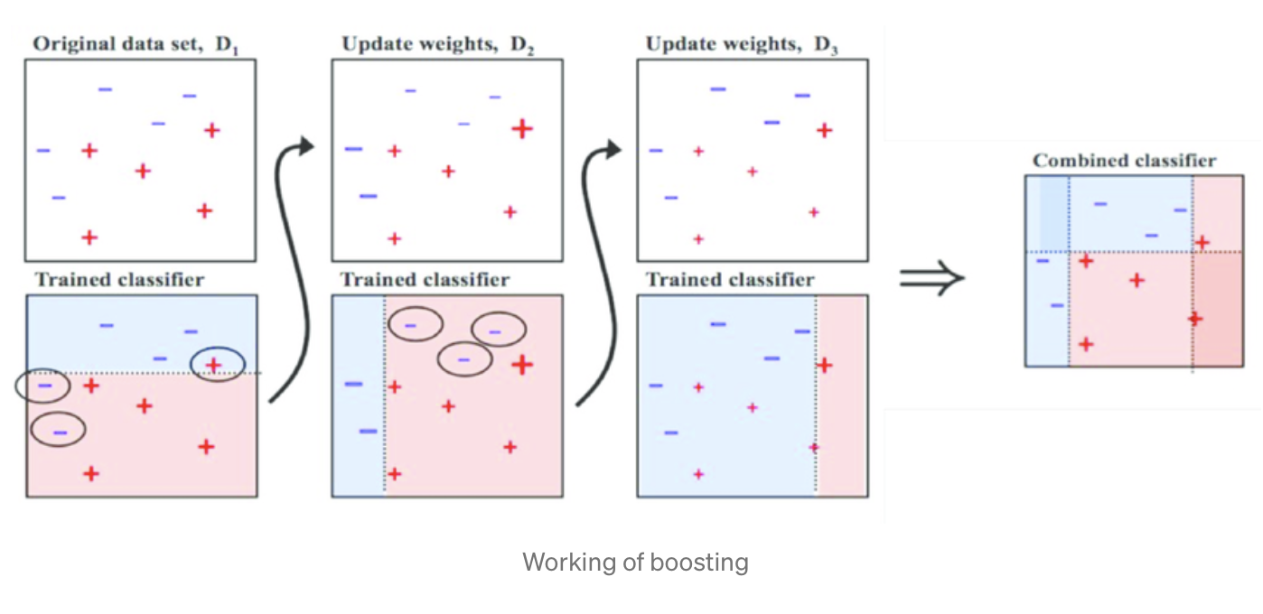
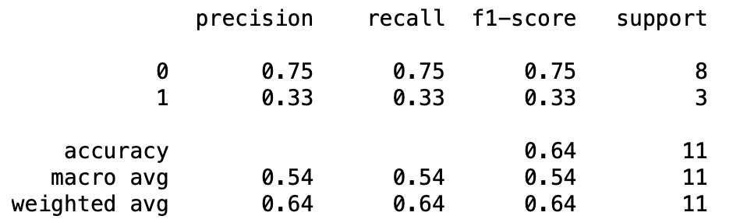
Boosting:
Here with huge effort different also ensembled methods has been implemented which is augmenting the performance of already existing models.
Boosting is also said to be one of the most effective and most commonly used as an ensemble classifier.
The most important motive which is for boosting can also be said to reduce biases in the model.

Slide 32
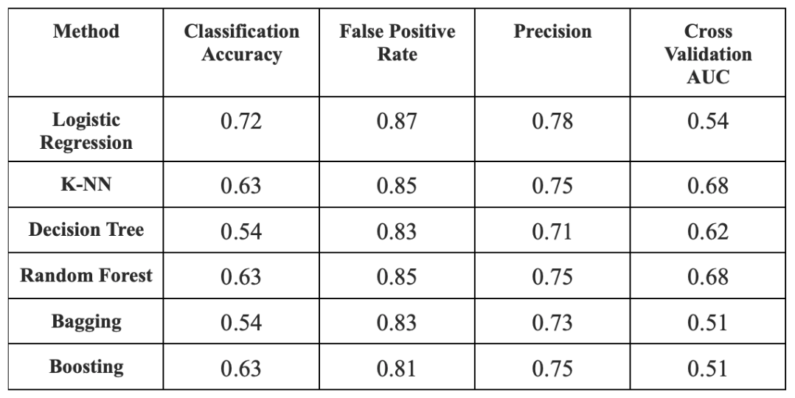
RESULT
Machine learning models have been constructed using Python and Scikit-learn [5] for validating all predictions and identifying whether or not a person requires therapy.
Logistic Regression, with the maximum classification accuracy of 72 %.
The lowest accuracy of 54 % for bagging and decision tree.
KNN, Random Forest classifier and the Boosting all share the same classification accuracy.
Random Forest classifier and KNN classifier having highest Cross Validation AUC indicating that these two models are more stable than the others.

Slide 33
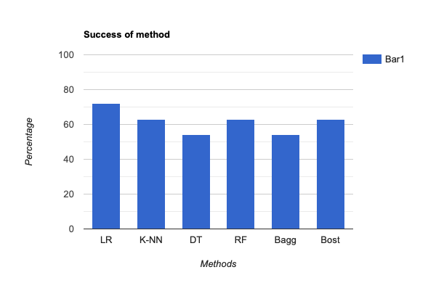

Slide 34
CONCLUSION
Work From Home concept for IT professionals is proven to be a huge stress reliever as compared to IT professionals working in from office.
Different factors like spending more time with family and working under the same roof whole day has increased the efficiency of IT professionals.
Strong bond with the partner and family has acted as a stress relief.
Increase in working hour has increased the efficiency among employees which is a plus point for the organisation.
A supportive environment and the absence of peer pressure in the organizational premises has made IT professionals increase their productivity.
Financial stability has increased during Work From Home.
More than 55% of IT professionals are willing to work from home permanently.
Companies like Google, Microsoft and many have already implemented hybrid working model.

Slide 35
FUTURE WORK
The problem discussed in this thesis is an open ended problem which deals with the issues that have more dimensions to explore which gives a space for improvement in the current work. Collection of data with more varied parameters is to be done and more complex algorithms like Naive Bayes, Gradient Descent and C-NN can be implemented. In future we may add more detailed descriptions and try to figure out the root causes of a person having stress. In future customization of the survey which is taken in order to achieve the responses in the right format and also there will be an urge and always a challenge to increase the no of attributes to predict the mental stress among IT professionals.

Slide 36
REFERENCES
[1] Bhattacharyya, R.,& Basu, S.(2018). India Inc looks to deal with rising stress in employees. Retrieved from ‘The Economic Times’
[2] Van den Broeck, J., Cunningham, S. A., Eeckels, R., & Herbst, K.(2005). Data Cleaning: detecting, diagnosing, and editing data abnormalities. PLoS medicine, 2(10),e267
[3] Shwetha, S, Sahil, A, Anant Kumar J, (2017) Predictive analysis using classification techniques in healthcare domain, International Journal of Linguistics & Computing Research, ISSN: 2456-8848, Vol. I, Issue. I, June-2017
[4] Tomar, D., & Agarwal, S.(2013). A survey on Data Mining approaches for Healthcare. International Journal of Bio-Science and Bio-Technology,5(5),241-266
[5] Pedregosa, F., Varoquaux, G., Gramfort, A., Michel, V., Thirion, B., Grisel, O., & Vanderplas, J. (2011). Scikit-learn: Machine learning in Python. Journal of machine learning research, 12(Oct), 2825-2830.
[6] Gender and Stress. (n.d.). Retrieved from APA press release 2010

Slide 37
Tools & Technology
Google Forms
Jupyter notebook
Python

Slide 38
Thank You

